Slide 1

Miniproject Presentation on AgricultureConnect: Harnessing IoT for Sustainable Farming
D. Y. Patil College of Engineering, Akurdi, Pune 411044
Electronics and Telecommunication Department
Group Members:
Sr. No. Seat No. Name of Student
1 T190083006 Aman Jee
2 T190083012 Prathamesh Bale
3 T190083124 Samiksha Anand
Under the Guidance
of
Mrs. Usha Jadhav

Slide 2
Outline of Presentation
Title
Aim and Objectives
Specifications
Block Diagram
Circuit Diagram
Selection of components, calculations
Simulation Results
PCB Art work
Testing Procedures
Enclosure Design
Test Results & Conclusion
References

Slide 3
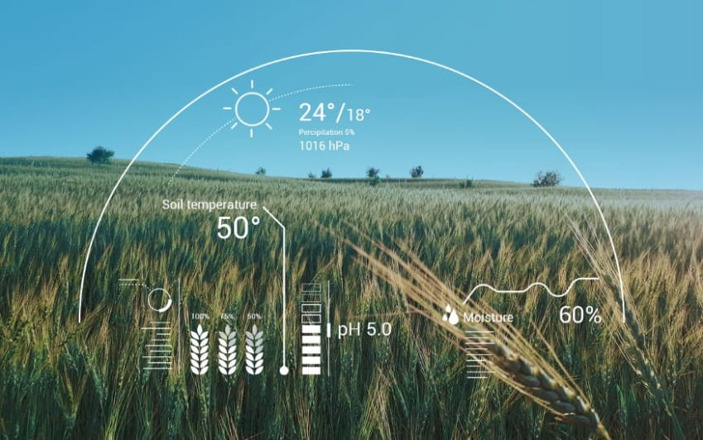
AgricultureConnect: Harnessing IoT for Sustainable Farming

Slide 4
Aim and Objectives
The main aim of our project is to protect the crops and maintain environment sustainability which aim to optimize agricultural productivity while minimizing environmental impact and ensuring food security . To address this challenge, innovative technologies such as IOT have emerged as powerful tools in the agricultural sector which aims to revolutionize traditional farming practices by providing farmers with real-time monitoring and control over key environmental parameters crucial for crop health and productivity.

Slide 5
SPECIFICATIONS
DHT11 Sensor – Operating voltage is 3.5V-5.5V.
Operating current is 0.3mA.
Humidity range is 20-90% with 5% accuracy.
Temperature range is 0-50 °C with +-2 °C accuracy.
Soil Moisture sensor –Operating voltage is 3.3 V - 5V .
Operating current is 25 mA .
Working temperature of the sensor 10 – 30 C.
Interface type is Analog.
Acoustic sensor Max4466 – Operating voltage is 2.4-5.5 V.
DC Range is 11.5V-20V.
Frequency response is flat to within=+-3db from .05hzto200hz.
Normal Sensitivity is 1Hz.
5V DC Pump – Input Voltage is 3V-5V.
Operating current is 0.1-0.2A.

Slide 6
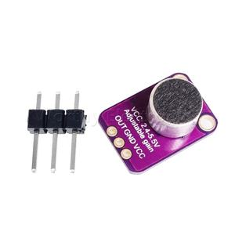
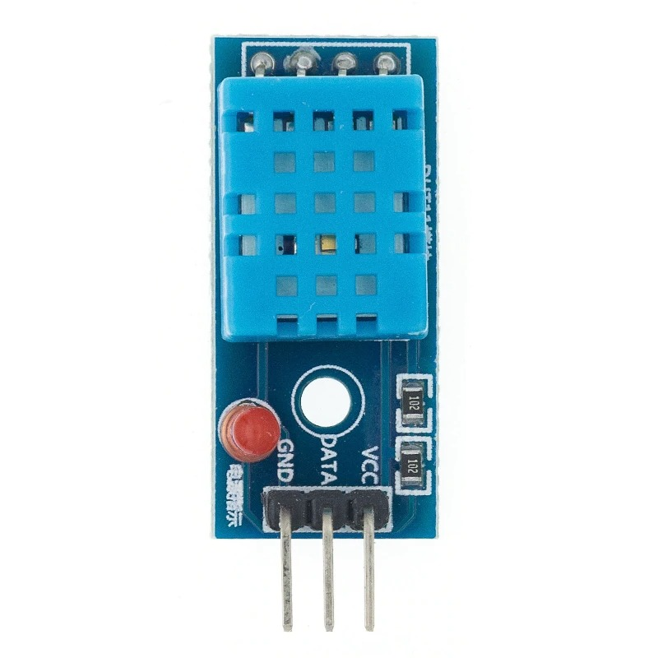
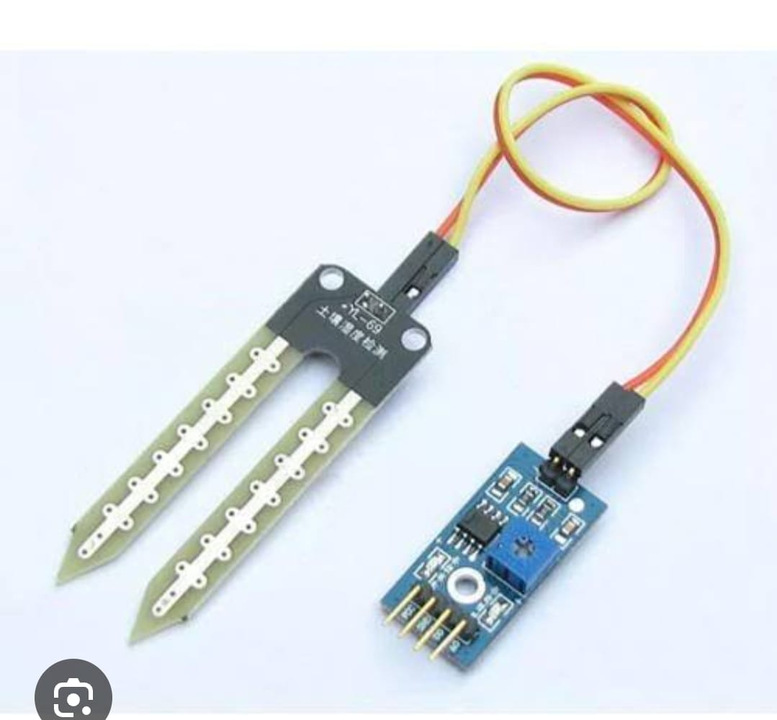
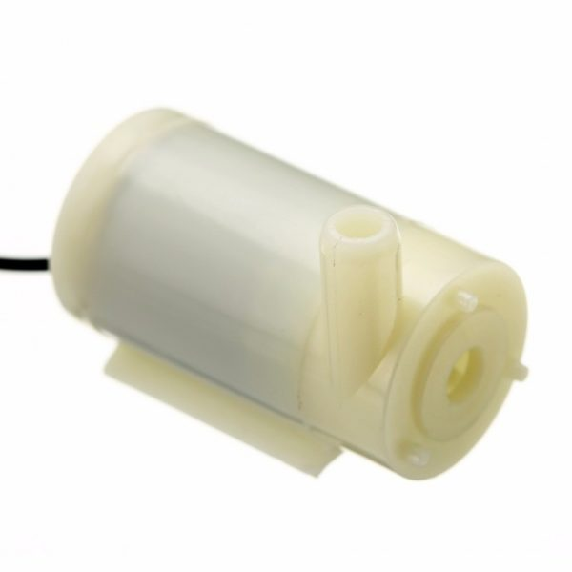
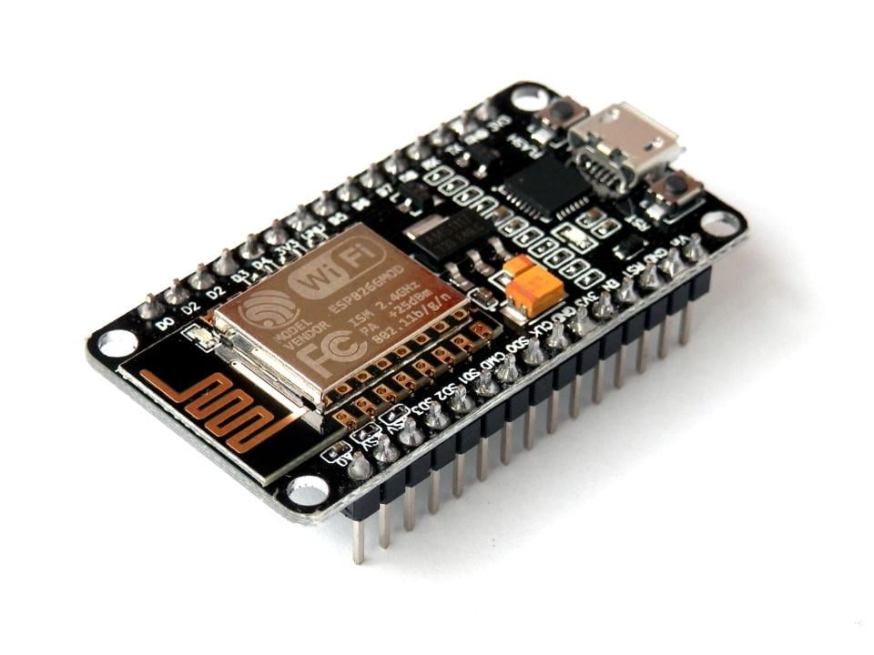
COMPONENTS

Slide 7
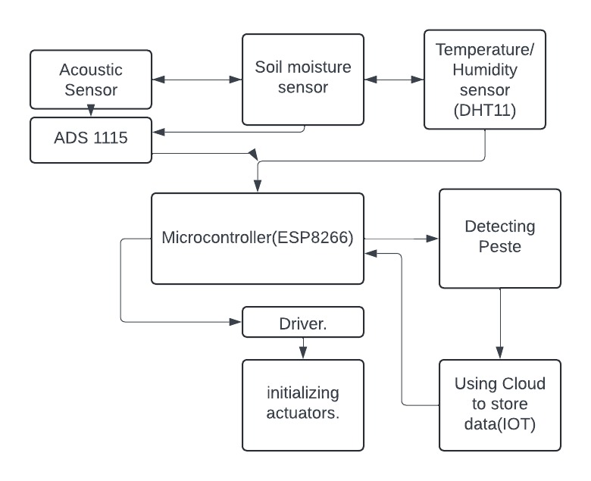
BLOCK DIAGRAM

Slide 8
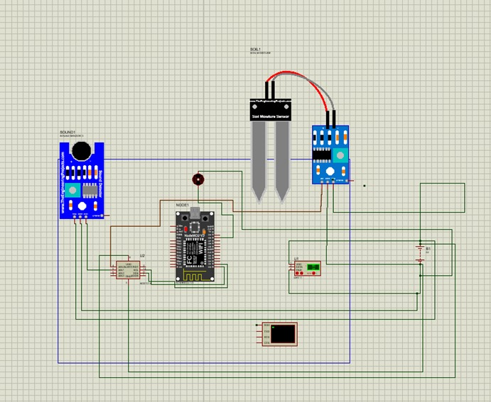
SIMULATION RESULTS

Slide 9
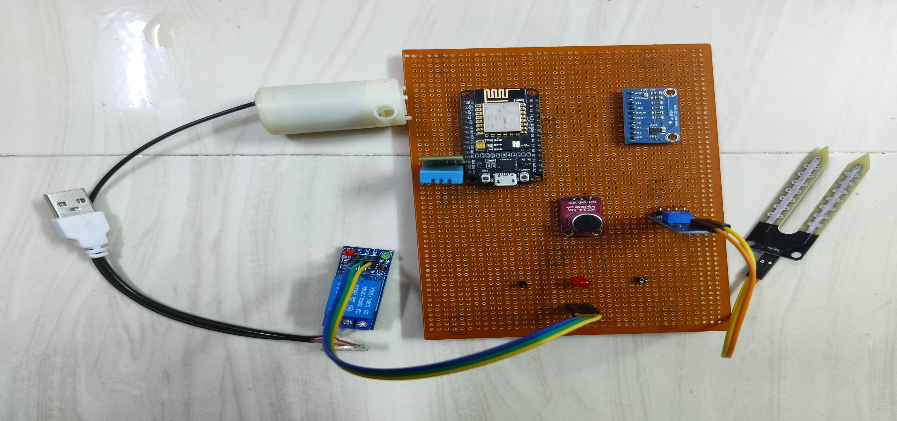
PCB Design

Slide 10
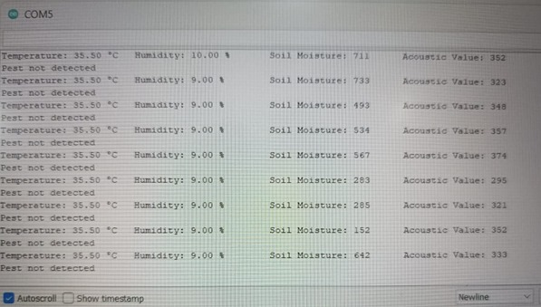
TEST RESULTS

Slide 11
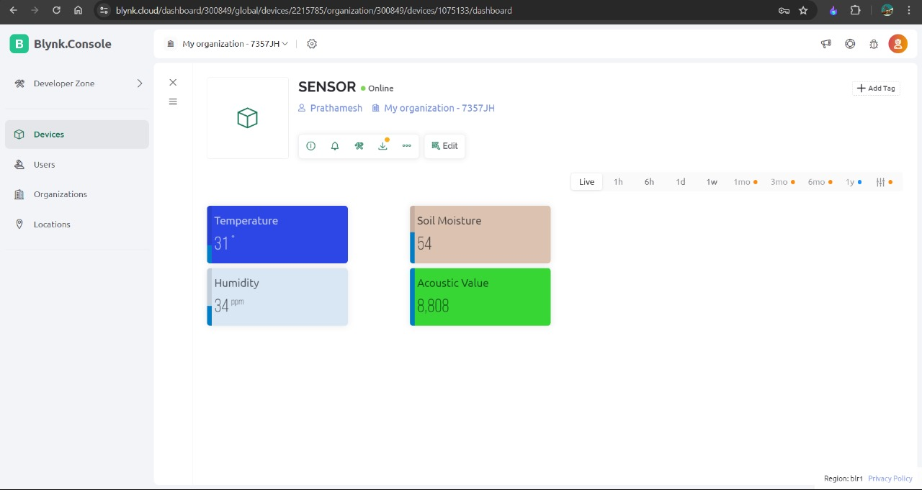
TEST RESULTS

Slide 12
References
[1] Damini Kalra, Praveen Kumar, K. Singh, Apurva Soni “Sensor Based Crop Protection System with IoT monitored Automatic Irrigation” 2nd International conference on Advances in Computing, Communication Control and Networking, 2020.
[2] M. Jaya Prabha, R. ramprabha, V VasuBindhra, C. AshaBeula “Sart Crop Protection System From Animals” International Journal of Engineering and Advanced Technology ISSN: 2249-8958, Vol.:9, Issue: 4 april,2020
[3] S. Giordano, Ilias Nektarios Seitanidis, Mike Oluwatayo Ojo, Davide Adami “IoT solutions for crop protection against wild animal attacks” 2018 IEEE International Conference on Environmental Engineering (EE), March 2018
[4] G. NaveenBalaji, V. Nandhini, S. Mithra, N. Priya , R. Naveena, “IOT based smart crop monitoring in farm land ”,Imperial Journal of Interdisciplinary Research (IJIR), Volume 04, Issue 01 , Nov 2018.
[5] TanmayBaranwal”Development of IOT based Smart Security and Monitoring Devices for Agriculture”,Department of Computer Science Lovely Professional University Phagwara, Punjab, IEEE-2016.

Slide 13
References
[6] HarshalMeharkure,ParagYelore,heetalIsrani, “Application of IOT based System for Advance Agriculture in India”, International Journal of Innovative Research in Computer and Communication Engineering(IJIRCCE) Vol. 3, Issue 11, pp. 10831-10837, 2015.
[7] BalajiBhanu, RaghavaRao, J.V.N. Ramesh and Mohammed Ali hussain, “Agriculture Field Monitoring and Analysis using Wireless Sensor Networks for improving Crop Production”, Eleventh International Conference on Wireless and Optical Communications Networks (WOCN).2014.
[8] Q. Wang, A. Terzis and A. Szalay, ―A Novel Soil Measuring Wireless Sensor Network‖, IEEE Transactions on Instrumentation and Measurement, pp. 412–415, 2010
[9] Joe-Air Jiang, ―Becoming technological advanced - IOT applications in smart agriculture‖, APAN 38th meeting, 11-15 August 2014.
[10] https://nevonprojects.com/smart-crop-protection-system-from-animals-pic/

Slide 14
THANK YOU

